Slide 1
3D Image Segmentation and Quantification of Lysosomes
18/12/2025

Slide 2


Script
Preview script
Last update script

Slide 3
FILES
40A_UAS-TMEM1923x-HA x 71G10 40A MARCM_L3_1_Airy_010724
Airy scan_40A_UAS-TMEM-HA_CB_0h_1_051222

Slide 4
40A_UAS-TMEM1923x-HA x 71G10 40A MARCM_L3_1_Airy_010724

Slide 5
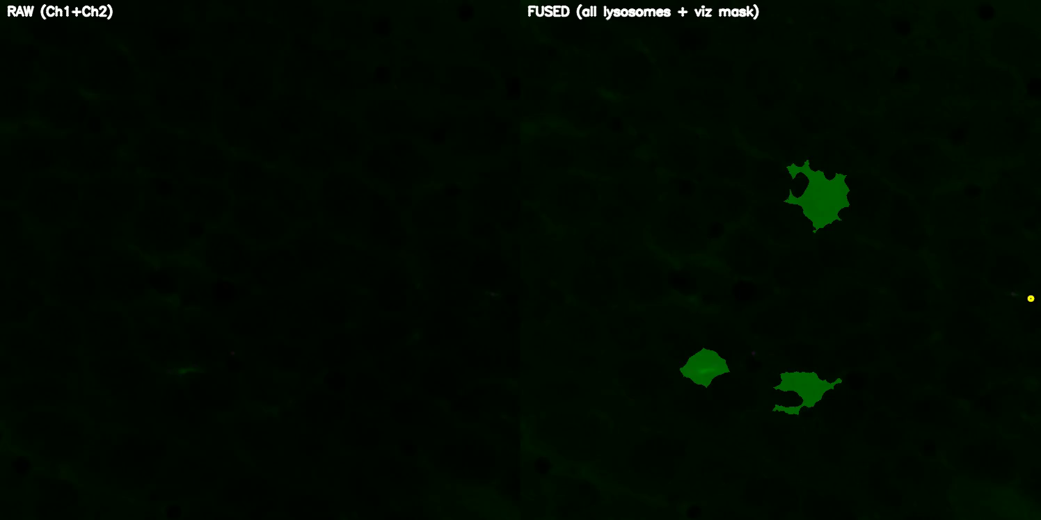
DETECTION VIDEO

Slide 6
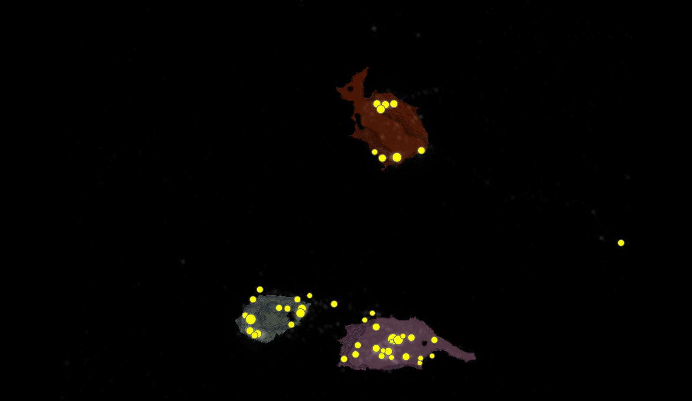




SEGMENTATION
1
2
3

Slide 7
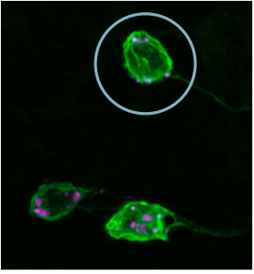
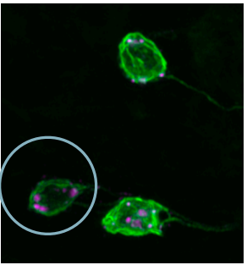
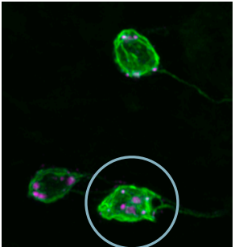
MANUAL.vs.AUTOMATIC
1
2
3

Slide 8

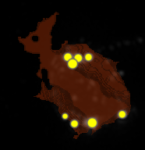




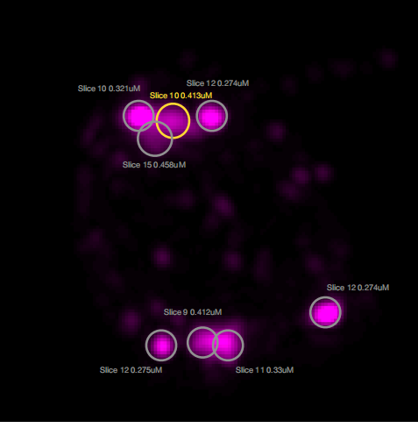



MANUAL.vs.AUTOMATIC
1
2
1
5
8
3
6
4
7

Slide 9


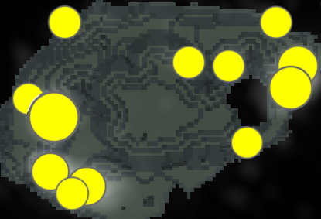






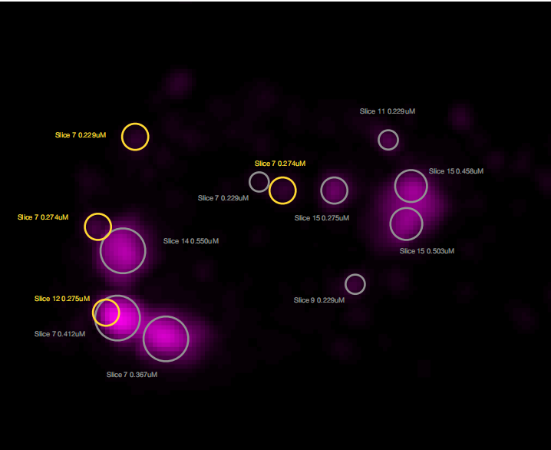




MANUAL.vs.AUTOMATIC
2
7
1
12
3
11
9
2
4
10
5
6
8

Slide 10
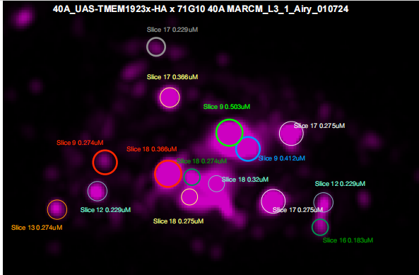



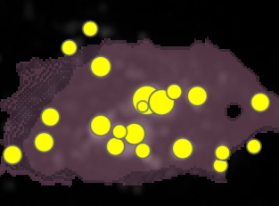


















MANUAL.vs.AUTOMATIC
17
10
3
16
8
11
2
1
3
5
13
18
19
12
9
7

Slide 11
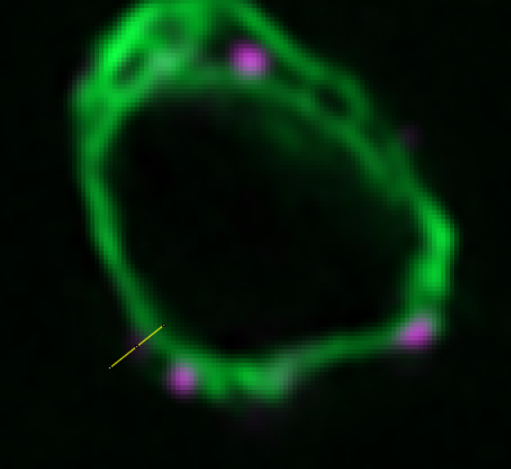
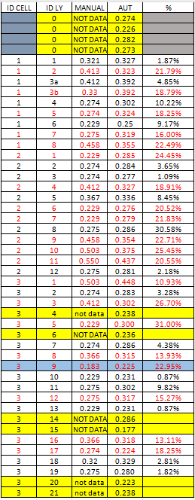
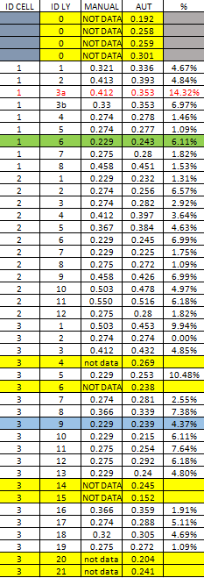
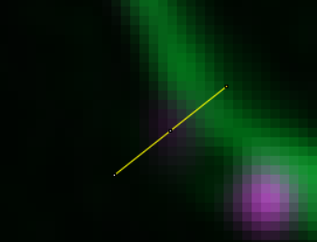
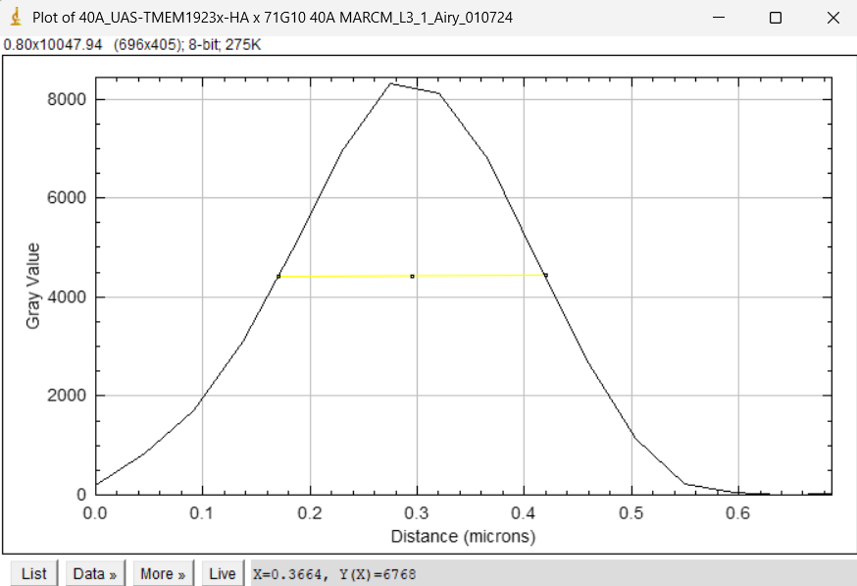
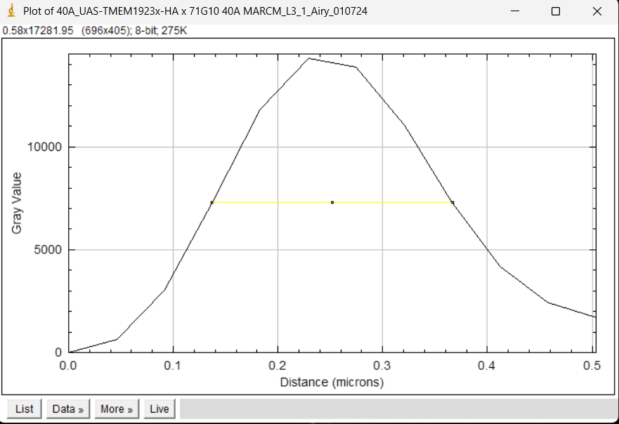
MANUAL.vs.AUTOMATIC
PREVIOUS DATA
NEW DATA

Slide 12
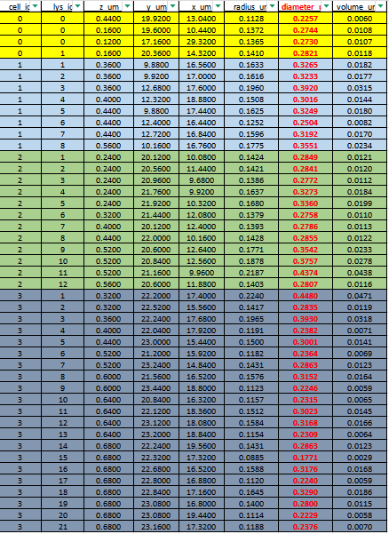

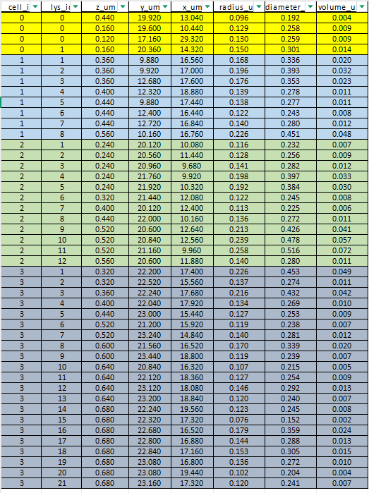

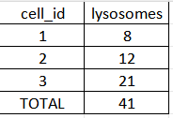

DATASET LYSOSOMES(ORDER FOR CELL ID)
PREVIOUS DATA
NEW DATA

Slide 13
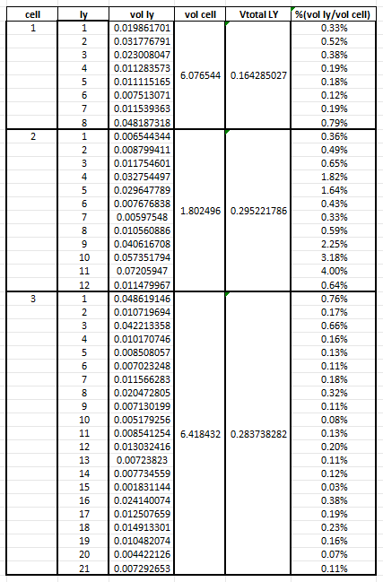


DATASET LYSOSOMES

Slide 14
Airy scan_40A_UAS-TMEM-HA_CB_0h_1_051222

Slide 15
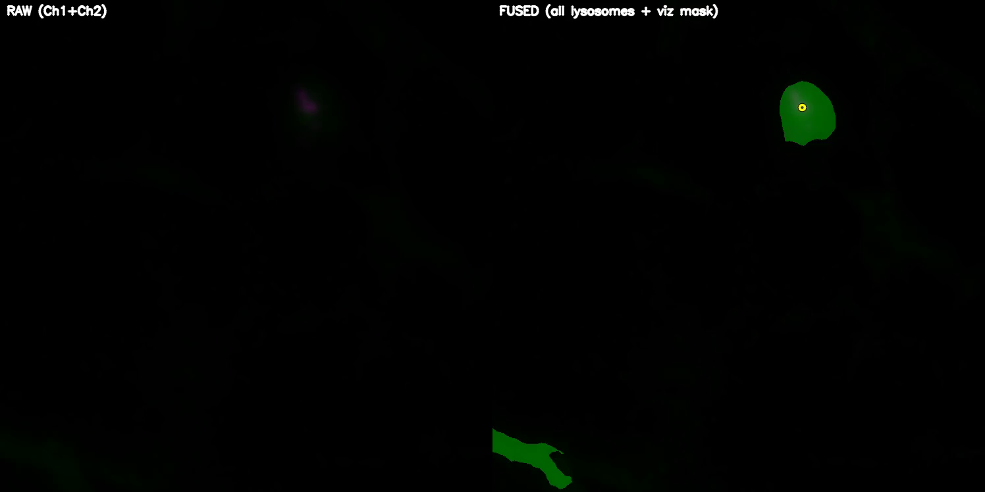
DETECTION VIDEO

Slide 16
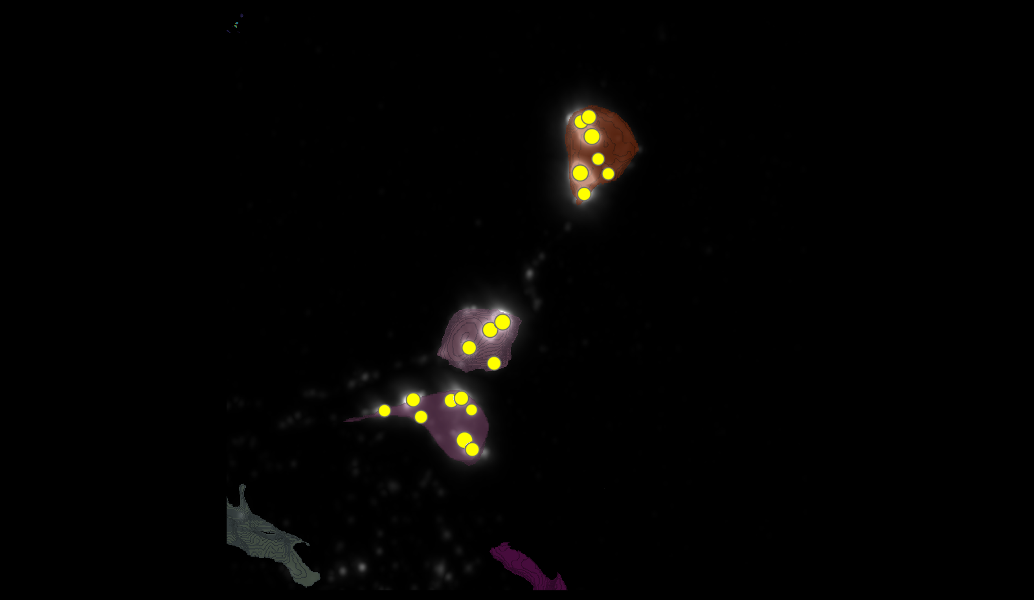
SEGMENTATION
1
3
5

Slide 17
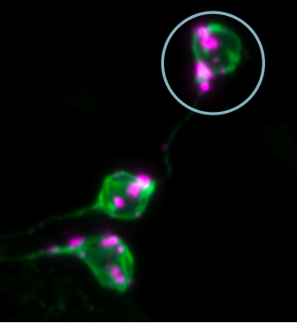
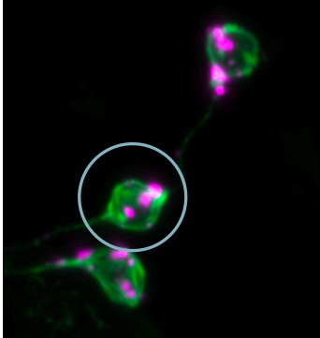
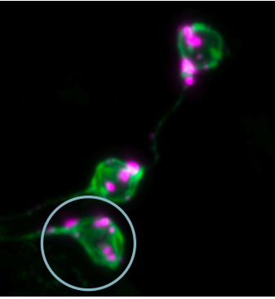
MANUAL.vs.AUTOMATIC
1
3
5

Slide 18




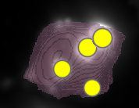
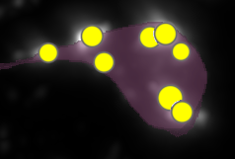








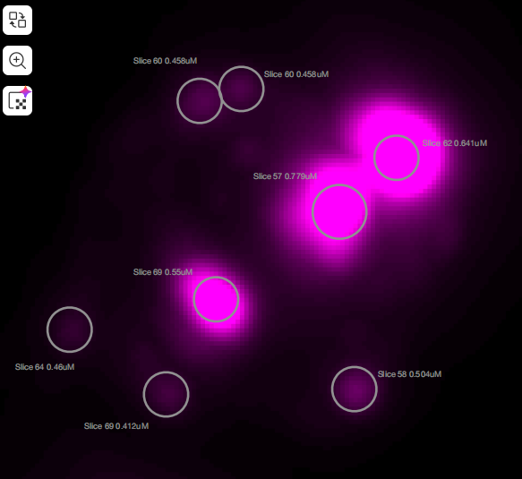
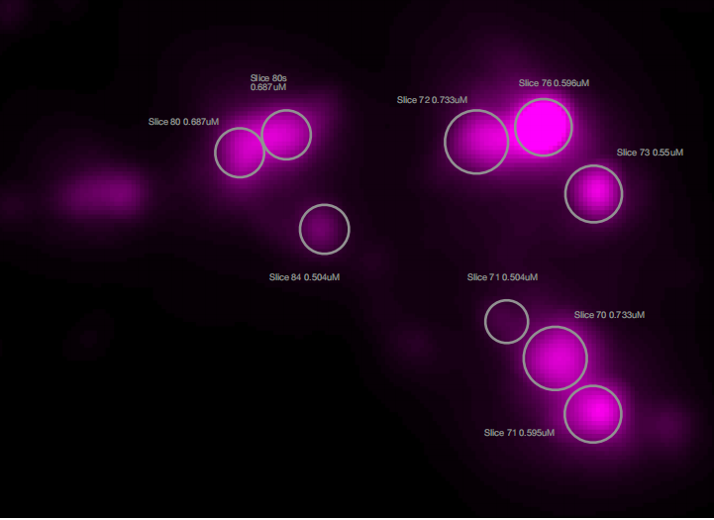
MANUAL.vs.AUTOMATIC
3
7
3
5
1
4
8
4
6
1
2
2

Slide 19


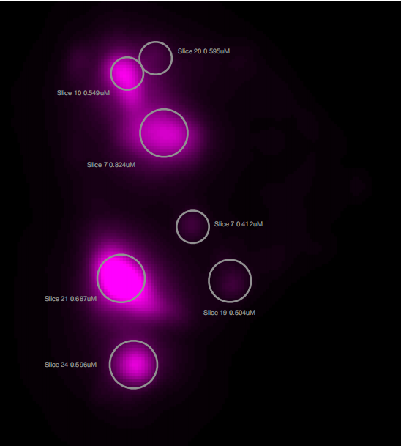






MANUAL.vs.AUTOMATIC
4
3
1
2
5
6
7

Slide 20
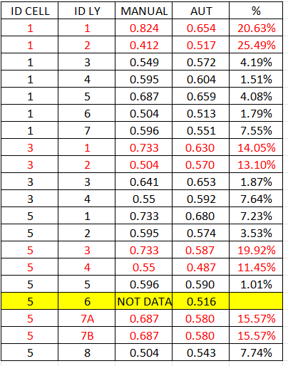
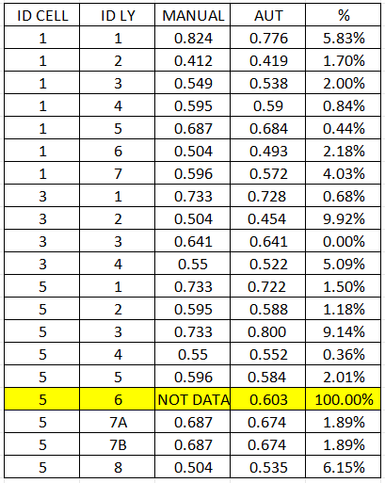
MANUAL.vs.AUTOMATIC
PREVIOUS DATA
NEW DATA

Slide 21
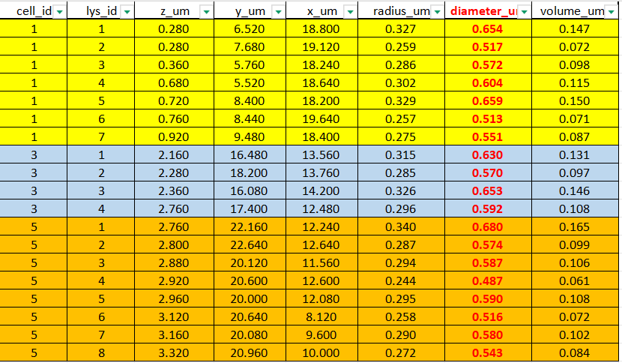
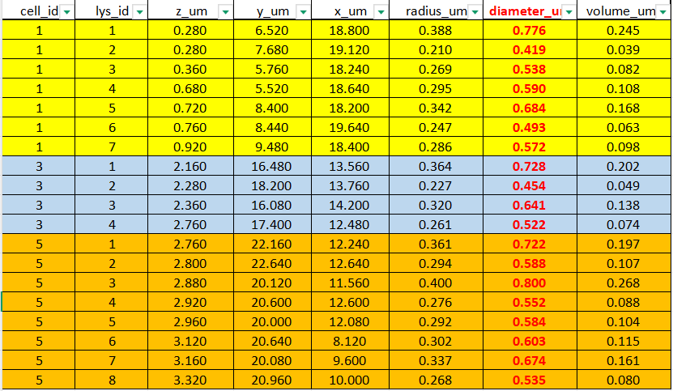


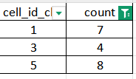

DATASETS
PREVIOUS DATA
NEW DATA

Slide 22
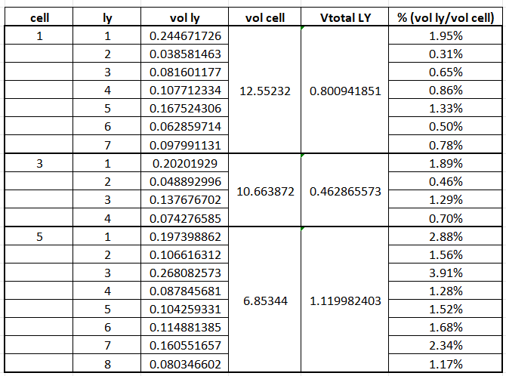
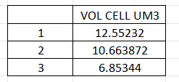
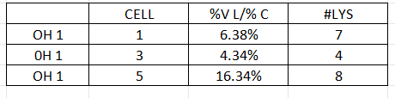
DATASET LYSOSOMES

Slide 23
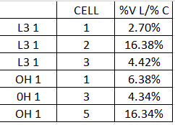
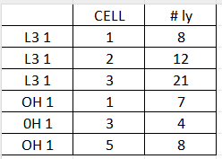
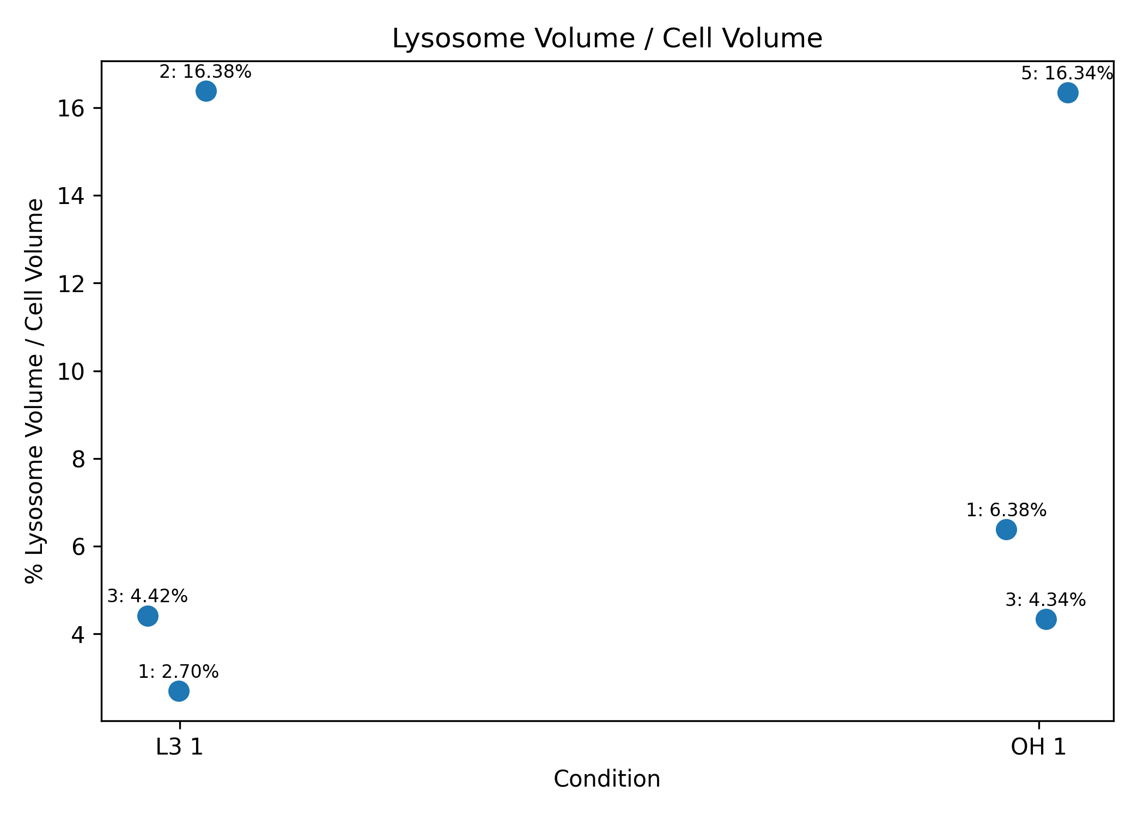
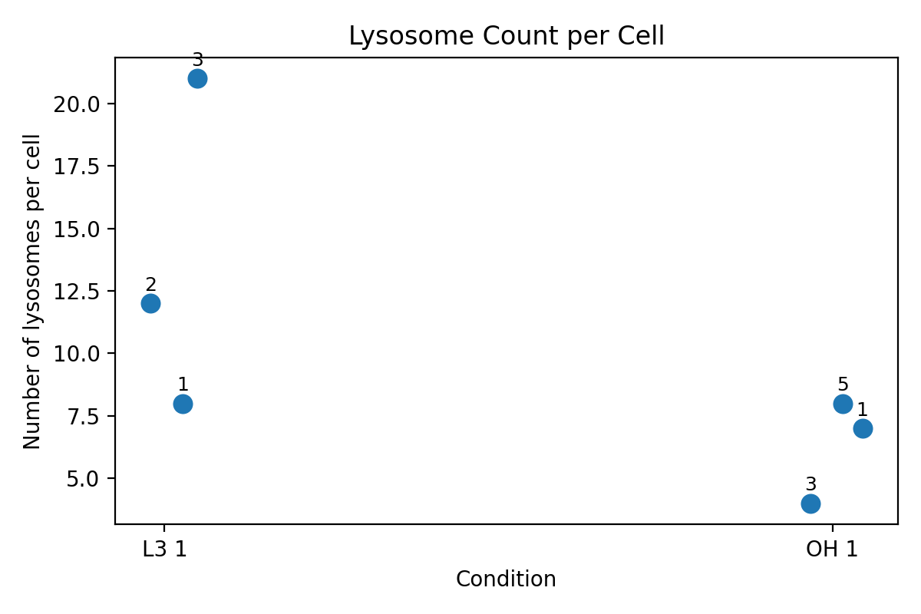
PLOT

